Slide 1


LOAM
Janu 13, 2023
CONTACT
Electrical Engineering
1st Engineering Building Room 201
Tel. +82 52 217 3542 Web. http://eche.unist.ac.krAddress

Slide 2
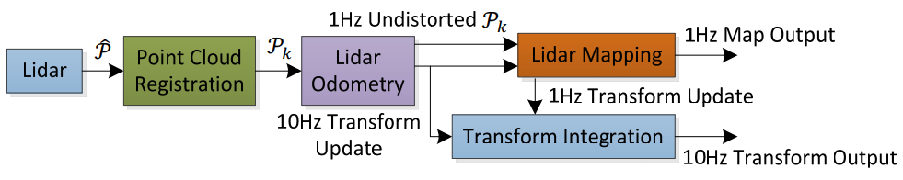

LOAM
Lidar Odometry And Mapping in Real-time
Lidar Odometry
Calculate Relative pose (with some error) of continuous LIDAR sweep
Active in 10Hz
Lidar Mapping in Real-time
Correct the pose by matching the Global PointCloud and Current measurement
Active in 1Hz -> 처리해야 할 연산량이 많기 때문에 저주파수
Block diagram of Lidar Odometry and Mapping software System

Slide 3
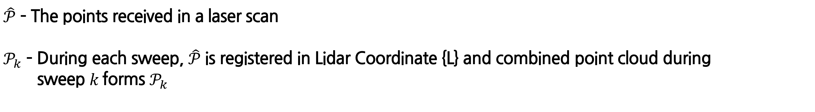
LOAM
Software System
$\hat{𝒫}$ – The points received in a laser scan
$𝒫_{k}$ – During each sweep, $\hat{𝒫}$ is registered in Lidar Coordinate {L} and combined point cloud during
sweep $k$forms $𝒫_{k}$

Slide 4
LOAM
Software System
Lidar Odometry
: Calculate Relative Motion of lidar using 2 consecutive sweeps (10Hz)
Lidar Mapping
: Matching Offline Map with Odometry by undistorted PointCloud (1Hz)
Transform Integration
: Calculate Transform by Odometry (10Hz) and Mapping (1Hz)

Slide 5
LIDAR Odometry
A. Feature Point Extraction
B. Finding Feature Point Correspondence
-> Feature Point 를 통한 distance 계산
C. Motion Estimation
-> Feature Point 와 distance matching을 통한 Motion Estimation

Slide 6
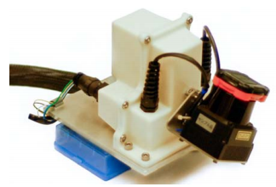
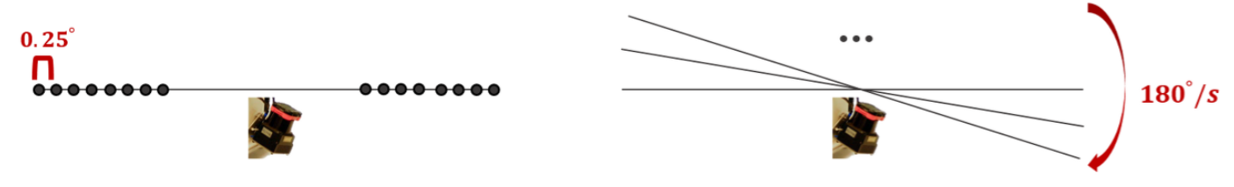
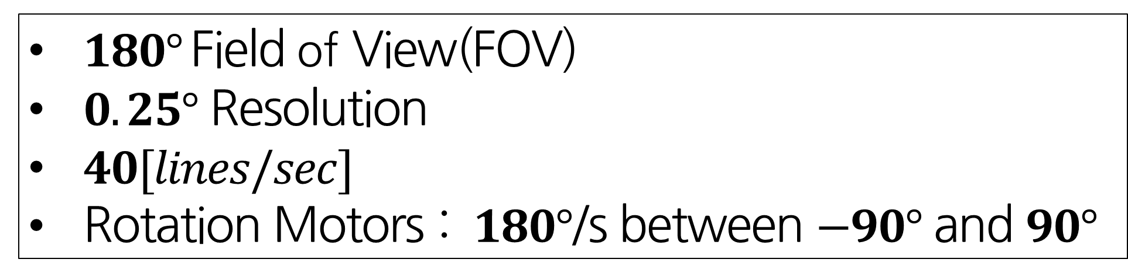

LOAM
Lidar Hardware
$180°$ Field of View(FOV)
$0.25°$ Resolution
$40[lines/sec]$
Rotation Motors : $180°$/s between $−90°$ and $90°$
<Hokuyo UTM-30LX 2D LiDAR>
$0.25°$ Resolution
Rotation Motors : $180°$/s between $−90°$ and $90°$

Slide 7
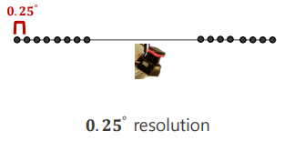
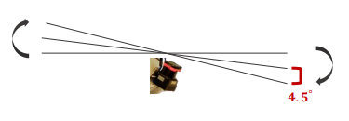
LIDAR Odometry
A. Feature Point Extraction
Laser Scanner rotates at an angular speed of $180°/s$ and generates scans at 40$Hz$
The resolution in the perpendicular direction to the scan planes $180°/40$ $=4.5°$
<Resolution in horizontality>
<Resolution in perpendicular>

Slide 8
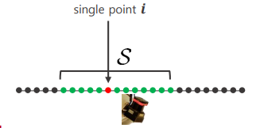
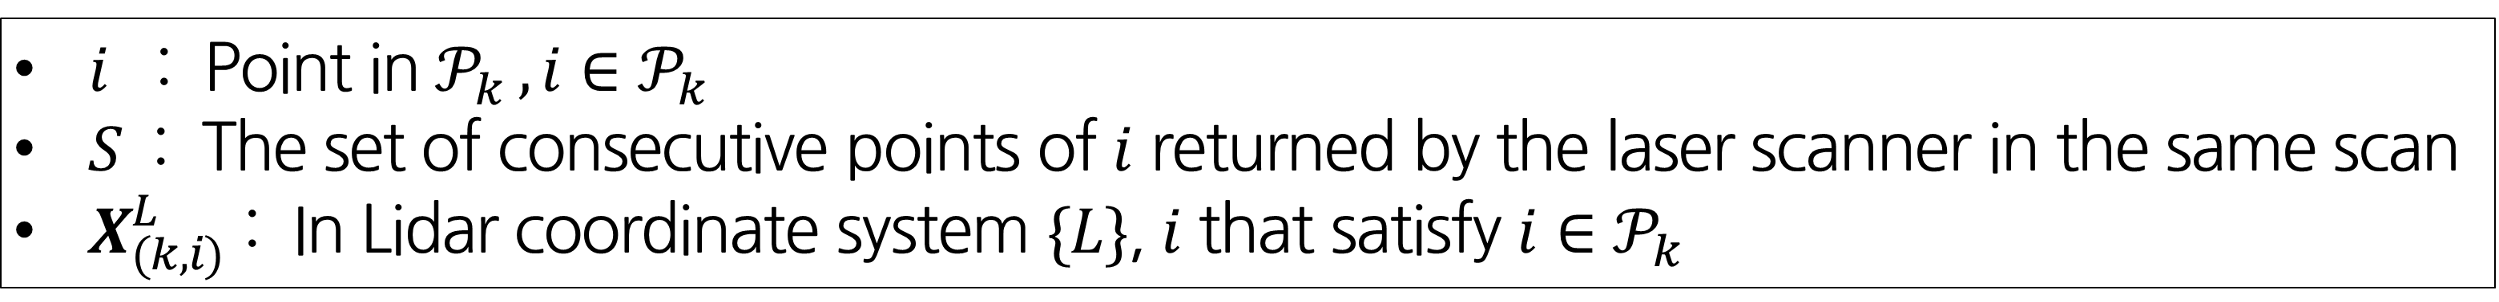

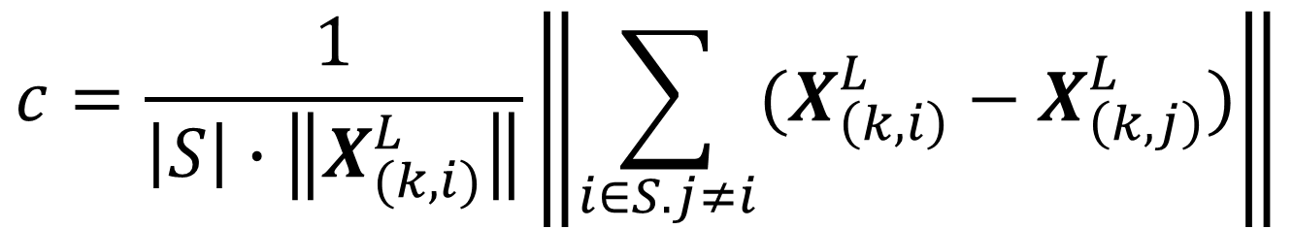
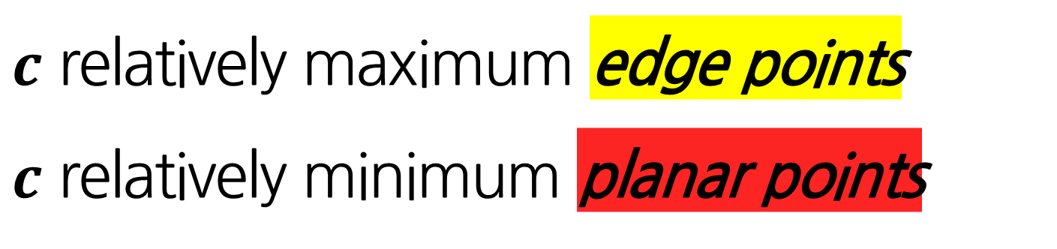
LIDAR Odometry
A. Feature Point Extraction
$i$ : Point in $𝒫_{k} , i∈𝒫_{k}$
$S$ : The set of consecutive points of $i$ returned by the laser scanner in the same scan
$X_{(k,i)}^{L}$ : In Lidar coordinate system $\{L\}$, $i$ that satisfy $i∈𝒫_{k}$
Curvature
-> The points in scan are sorted based on $c$ value
$$c=\frac{1}{\left|S\right|∙\left\|X_{(k, i)}^{L}\right\|}\left\|\sum_{i∈S. j≠i}{(X_{\left(k,i\right)}^{L}−X_{\left(k,j\right)}^{L})}\right\|$$
$c$ relatively maximum edge points
$c$ relatively minimum planar points
Feature Point
Notes:
Curvature : 곡률

Slide 9
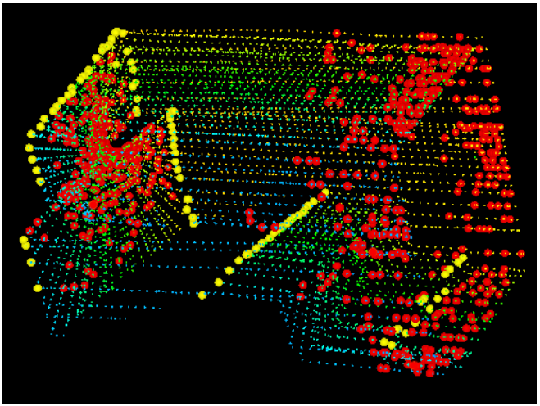
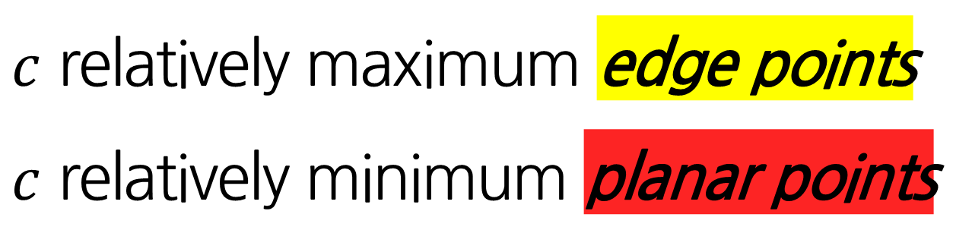
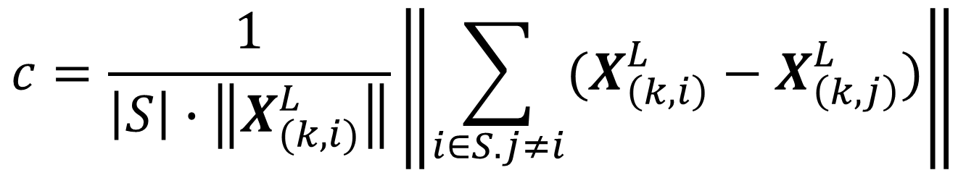
LIDAR Odometry
A. Feature Point Extraction
Curvature
-> The points in scan are sorted based on $c$ value
$$c=\frac{1}{\left|S\right|∙\left\|X_{(k, i)}^{L}\right\|}\left\|\sum_{i∈S. j≠i}{(X_{\left(k,i\right)}^{L}−X_{\left(k,j\right)}^{L})}\right\|$$
$c$ relatively maximum edge points
$c$ relatively minimum planar points
Feature Point
Lidar cloud taken in a corridor
The Lidar moves toward the wall on the left side
-> This results in motion distortion on the wall
Notes:
Curvature : 곡률

Slide 10
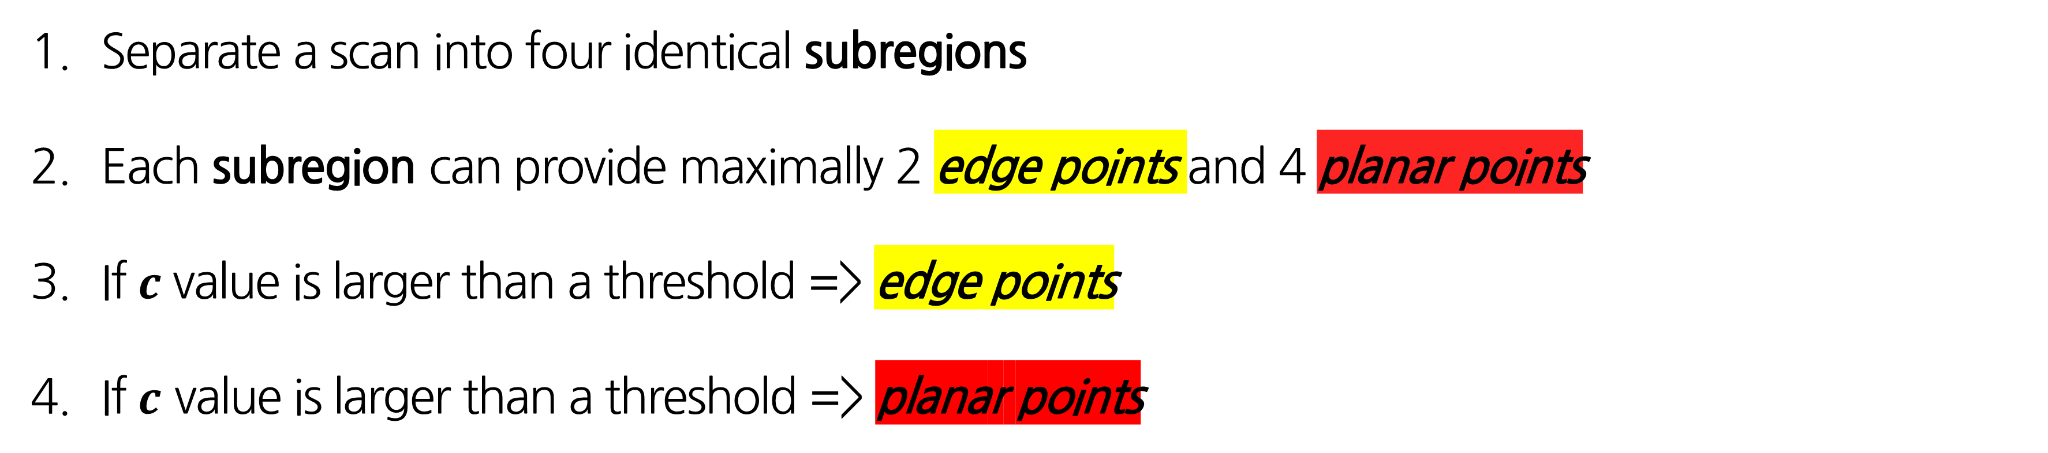
LIDAR Odometry
A. Feature Point Extraction
Curvature
$$c=\frac{1}{\left|S\right|∙\left\|X_{(k, i)}^{L}\right\|}\left\|\sum_{i∈S. j≠i}{(X_{\left(k,i\right)}^{L}−X_{\left(k,j\right)}^{L})}\right\|$$
After calculate Curvature
Separate a scan into four identical subregions
Each subregion can provide maximally 2 edge points and 4 planar points
If $c$value is larger than a threshold => edge points
If $c$ value is larger than a threshold => planar points
Notes:
Curvature : 곡률

Slide 11
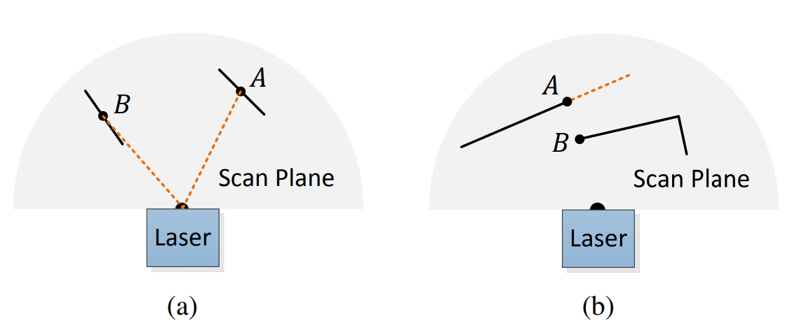
LIDAR Odometry
A. Feature Point Extraction
Exceptional case for choosing Feature point
Problem
Local planar surface that are roughly parallel to laser beam
->Misunderstand the plane as a point
(b) Point on boundary of occluded region
-> Misunderstand as an edge point
Notes:
Curvature : 곡률

Slide 12
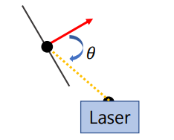
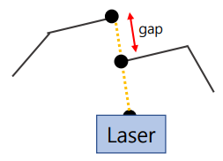
LIDAR Odometry
A. Feature Point Extraction
Exceptional case for choosing Feature point
Solution
Calculate the normal vector and angle with the Laser Beam of the Local Surface near point B,
If two angle difference is close to vertical
-> Make it as exception if two angle difference is close to vertical
(b) If there is a difference by a specific gap in the direction of the Laser Beam Between point A and B
-> Make it as exception
Notes:
Curvature : 곡률

Slide 13
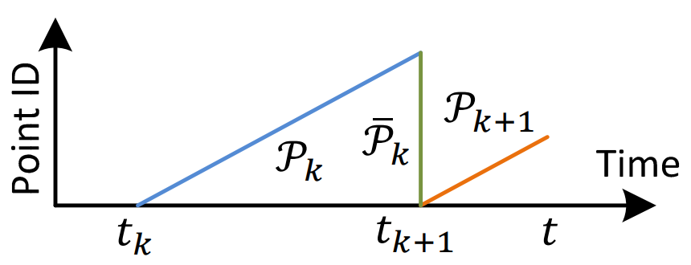
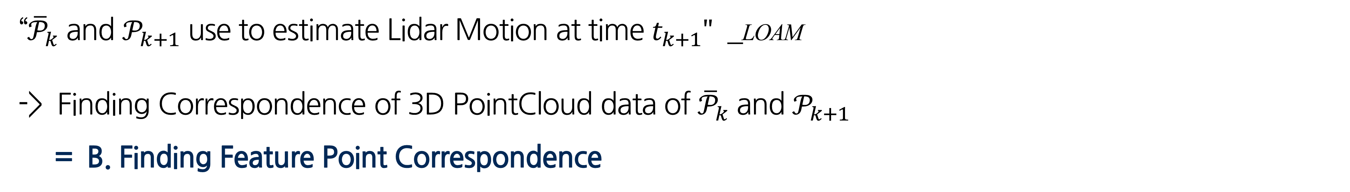
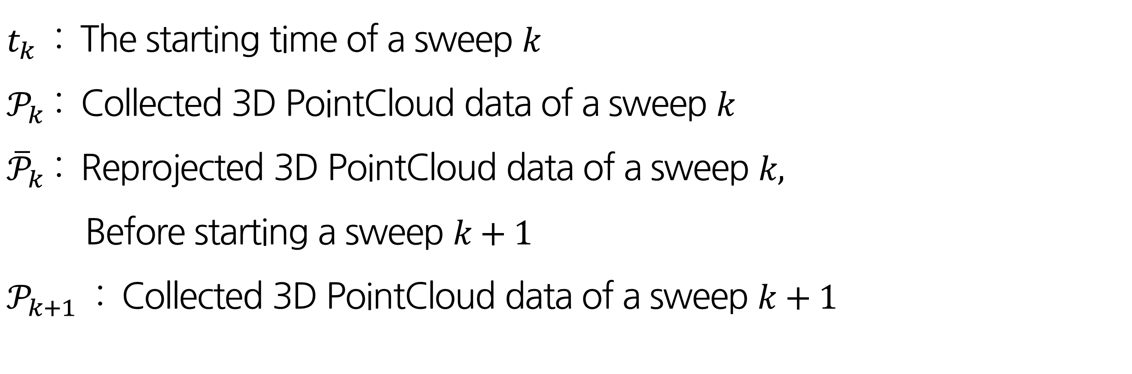
LIDAR Odometry
B. Finding Feature Point Correspondence
$t_{k}$ : The starting time of a sweep $k$
$𝒫_{k}$ : Collected 3D PointCloud data of a sweep $k$
${\overline{𝒫}}_{k}$ : Reprojected 3D PointCloud data of a sweep $k,$
Before starting a sweep $k+1$
$𝒫_{k+1}$ : Collected 3D PointCloud data of a sweep $k+1$
“${\overline{𝒫}}_{k}$ and $𝒫_{k+1}$ use to estimate Lidar Motion at time $t_{k+1}"$ _LOAM
-> Finding Correspondence of 3D PointCloud data of ${\overline{𝒫}}_{k}$ and $𝒫_{k+1}$
= B. Finding Feature Point Correspondence

Slide 14
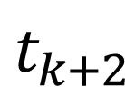
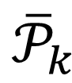
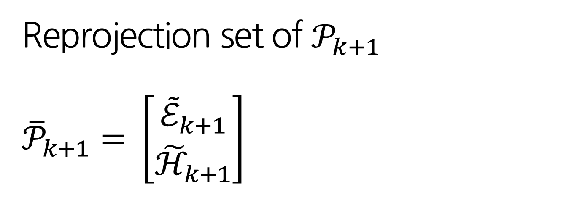
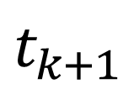
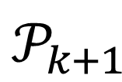
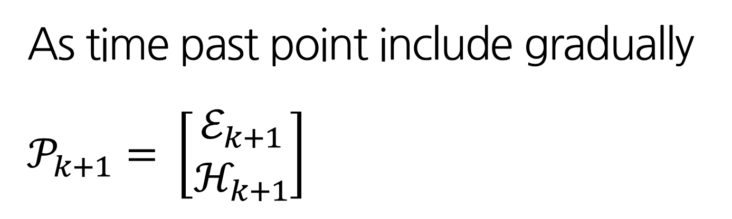
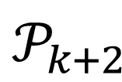
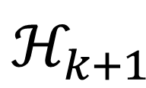
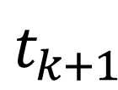
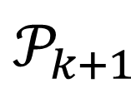

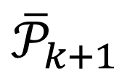
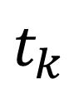
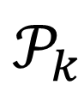
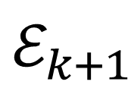

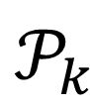
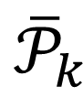
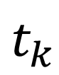
LIDAR Odometry
B. Finding Feature Point Correspondence
$ℰ_{k+1}$
$ℋ_{k+1}$
From A. Feature Point Extraction $𝒫_{k+1}$ is consist of edge points & planar points
As time past point include gradually
$$𝒫_{k+1}= \left[\begin{aligned}ℰ_{k+1} \\ ℋ_{k+1}\end{aligned}\right]$$
Point ID
$𝒫_{k}$
$𝒫_{k+1}$
${\overline{𝒫}}_{k}$
Time
$t_{k}$
$t_{k+1}$
$$t$$
Reprojection set of $𝒫_{k+1}$
$${\overline{𝒫}}_{k+1}= \left[\begin{aligned}{\tilde{ℰ}}_{k+1} \\ {\tilde{ℋ}}_{k+1}\end{aligned}\right]$$
Point ID
$𝒫_{k}$
$𝒫_{k+1}$
$𝒫_{k+2}$
${\overline{𝒫}}_{k}$
${\overline{𝒫}}_{k+1}$
Time
$t_{k}$
$t_{k+1}$
$t_{k+2}$
$$t$$

Slide 15
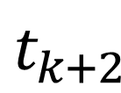
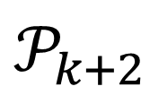
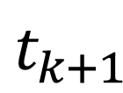
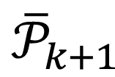

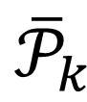
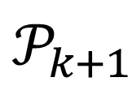
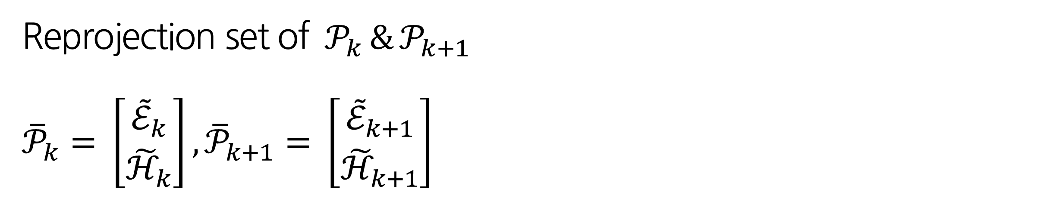
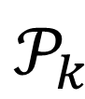
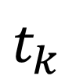
LIDAR Odometry
B. Finding Feature Point Correspondence
Point ID
$𝒫_{k}$
$𝒫_{k+1}$
$𝒫_{k+2}$
${\overline{𝒫}}_{k}$
${\overline{𝒫}}_{k+1}$
Time
$t_{k}$
$t_{k+1}$
$t_{k+2}$
$$t$$
Reprojection set of $𝒫_{k} \& 𝒫_{k+1}$
$${\overline{𝒫}}_{k}= \left[\begin{aligned}{\tilde{ℰ}}_{k} \\ {\tilde{ℋ}}_{k}\end{aligned}\right], {\overline{𝒫}}_{k+1}= \left[\begin{aligned}{\tilde{ℰ}}_{k+1} \\ {\tilde{ℋ}}_{k+1}\end{aligned}\right]$$
By finding the Closest Neighbor point of ${\overline{𝒫}}_{k}$ and ${\overline{𝒫}}_{k+1}$ -> Find Correspondence

Slide 16
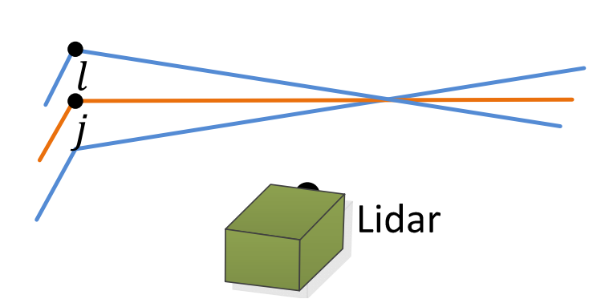
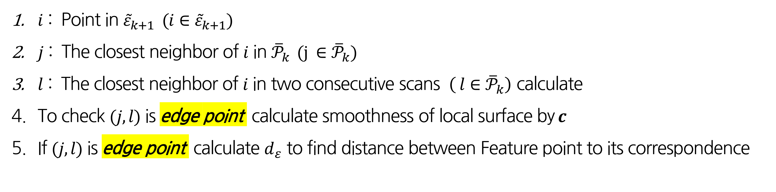
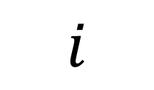
LIDAR Odometry
B. Finding Feature Point Correspondence
Feature point - edge points
$$i$$
$i$ : Point in ${\tilde{ε}}_{k+1}$ $(i∈{\tilde{ε}}_{k+1})$
$j$ : The closest neighbor of $i$ in ${\overline{𝒫}}_{k} (j ∈{\overline{𝒫}}_{k})$
$l$ : The closest neighbor of $i$ in two consecutive scans $\left( l∈{\overline{𝒫}}_{k}\right)$ calculate
To check $(j, l)$ is edge point calculate smoothness of local surface by$c$
If $(j, l)$ is edge point calculate $d_{ε}$ to find distance between Feature point to its correspondence
<Sweep k>
Notes:
The orange colored lines represent the same scan of j,
and the blue colored lines are the two consecutive scans.

Slide 17



LIDAR Odometry
B. Finding Feature Point Correspondence
$$i$$
Point to line distance
$$d_{ε}= \frac{\left|\left({\tilde{X}}_{\left(k+1,i\right)}^{L}−{\overline{X}}_{\left(k,j\right)}^{L}\right)×({\tilde{X}}_{\left(k+1,i\right)}^{L}−{\overline{X}}_{\left(k,l\right)}^{L})\right|}{\left|{{\overline{X}}_{\left(k,j\right)}^{L}−\overline{X}}_{\left(k,l\right)}^{L}\right|}$$
<Sweep k>
(a = ${\tilde{X}}_{(k+1, i)}^{L}−{\overline{X}}_{(k, j)}^{L}$ , b = ${\tilde{X}}_{(k+1, i)}^{L}−{\overline{X}}_{(k, l)}^{L}$ , C = $\left|{\overline{X}}_{(k, j)}^{L}− {\overline{X}}_{(k, l)}^{L}\right|$)
$$S=\frac{absinθ}{2}=\frac{c∙d_{ε}}{2}$$
$absinθ= \left|a×b\right|$ => CrossProduct
$${∴d}_{ε}=\frac{\left|a×b\right|}{c}$$

Slide 18



LIDAR Odometry
B. Finding Feature Point Correspondence
$$i$$
Feature point - planar points
$i$ : Point in ${\tilde{ε}}_{k+1}$ $(i∈{\tilde{ε}}_{k+1})$
$j$ : The closest neighbor of $i$ in ${\overline{𝒫}}_{k} (j ∈{\overline{𝒫}}_{k})$
$l$ : The closest neighbor of $i$ in same scan to the scan of $j$ $\left( l∈{\overline{𝒫}}_{k}\right)$ calculate
$m$ : The closest neighbor of $i$ in the other two consecutive scans to the scan of $j$ $\left( m∈{\overline{𝒫}}_{k}\right)$ calculate
To check $(j, l,m)$ is planar points calculate smoothness of local surface by$c$
If $(j, l,m)$ is planar points calculate $d_{ℋ}$ to find distance between Feature point to its correspondence
<Sweep k>

Slide 19



LIDAR Odometry
B. Finding Feature Point Correspondence
$$i$$
Point to plane distance
$$d_{ℋ}= \frac{\left|\begin{aligned}({\tilde{X}}_{\left(k+1,i\right)}^{L}−{\overline{X}}_{\left(k,j\right)}^{L}) \\ \left(\left({\overline{X}}_{\left(k,j\right)}^{L}−{\overline{X}}_{\left(k,l\right)}^{L}\right)×{(\overline{X}}_{\left(k,j\right)}^{L}−{\overline{X}}_{\left(k,m\right)}^{L})\right)\end{aligned}\right|}{\left|{{(\overline{X}}_{\left(k,j\right)}^{L}−\overline{X}}_{\left(k,l\right)}^{L})×{{(\overline{X}}_{\left(k,j\right)}^{L}−\overline{X}}_{\left(k,m\right)}^{L})\right|}$$
<Sweep k>
(a = ${\tilde{X}}_{(k+1, i)}^{L}−{\overline{X}}_{(k, j)}^{L}$ , b = ${\overline{X}}_{(k, j)}^{L}−{\overline{X}}_{(k, l)}^{L}$ , C =${\overline{X}}_{(k, j)}^{L}−{\overline{X}}_{(k, m)}^{L}$)
$\left|h\right|=\left|b×c\right|$ => CrossProduct
$$a∙\left|b×c\right|=a∙h= \left|a\right|\left|h\right|cosθ$$
$$∴d_{ℋ}=\left|a\right|cosθ=\frac{\left|a\right|\left|h\right|cosθ}{\left|h\right|}=\frac{\left|a\right|\left|b×c\right|cosθ}{\left|b×c\right|}$$

Slide 20




LIDAR Odometry
C. Motion Estimation
Premise => The lidar motion is modeled with constant angular and linear velocities during sweep
Assume => This allows us to use linear interpolation
Estimate the omitted the pose transform within a sweep for the points that are received at different times
$T_{k+1}^{L}$ : On starting time $t_{k+1}$ of sweep and lidar pose transform between $\left[t_{k+1}, t\right]$
$$T_{k+1}^{L}= {\left[t_{x}, t_{y}, t_{z}, θ_{x}, θ_{y}, θ_{z}\right]}^{T}$$
6-DOF
$t_{x}, t_{y}, t_{z}$ : translation along x- , y- and y- axes of {L}
$θ_{x}, θ_{y}, θ_{z}$ : Rotation angles(Right hand rule)

Slide 21













LIDAR Odometry
C. Motion Estimation
$T_{(k+1, i)}^{L}$ be pose transform between $\left[t_{k+1}, t\right]$ with a point $i, i ∈𝒫_{k+1}$
By using linear interpolation of $T_{k+1}^{L}$
Linear Interpolation
$$T_{(k+1, i)}^{L}=\frac{t_{i}−t_{k+1}}{t−t_{k+1}}T_{k+1}^{L}$$
$$\frac{T_{k+1}^{L}}{t−t_{k−1}} = \frac{T_{(k+1, i)}^{L}}{t_{i}−t_{k−1}}$$
=> $T_{(k+1, i)}^{L}=\frac{t_{i}−t_{k+1}}{t−t_{k+1}}T_{k+1}^{L}$
Point ID
$𝒫_{k}$
$𝒫_{k+1}$
$$T_{k+1}^{L}$$
${\overline{𝒫}}_{k}$
$$T_{(k+1, i)}^{L}$$
Time
$t_{k+1}$
$$t$$
$t_{k+1}$
$$t$$
$t_{i}$ - time stamp
$$t_{i}$$

Slide 22




LIDAR Odometry
C. Motion Estimation
Linear Interpolation
$$T_{(k+1, i)}^{L}=\frac{t_{i}−t_{k+1}}{t−t_{k+1}}T_{k+1}^{L}$$
Using Linear Interpolation establish a geometric relation between
$ℰ_{k+1}$ and ${\tilde{ℰ}}_{k+1}$ or $ℋ_{k+1}$ and ${\tilde{ℋ}}_{k+1}$
The lidar motion
$X_{(k+1, i)}^{L}$ : The coordinates of point $i in\left[\begin{aligned}ℰ_{k+1} \\ ℋ_{k+1}\end{aligned}\right]$
${\tilde{X}}_{(k+1, i)}^{L}$ : The coordinates of point $i in\left[\begin{aligned}{\tilde{ℰ}}_{k+1} \\ {\tilde{ℋ}}_{k+1}\end{aligned}\right]$
$T_{\left(k+1, i\right)}^{L}\left(1:3\right)= {\left[t_{x}, t_{y}, t_{z}\right]}^{T}$: 1st to 3rd entries of $T_{\left(k+1, i\right)}^{L}$
$$X_{(k+1, i)}^{L}= {R\tilde{X}}_{(k+1, i)}^{L}+T_{\left(k+1, i\right)}^{L}(1:3)$$
-> Reprojection
-> ICP

Slide 23


LIDAR Odometry
C. Motion Estimation
The lidar motion
$$X_{(k+1, i)}^{L}= {R\tilde{X}}_{(k+1, i)}^{L}+T_{\left(k+1, i\right)}^{L}(1:3)$$
A Rotation Matrix defined by the Rodrigues formula
Rotation Matrix
$$T_{\left(k+1, i\right)}^{L}\left(4:6\right)={\left[θ_{x}, θ_{y}, θ_{z}\right]}^{T} \text{: }\text{4}\text{th} \text{to}\text{ 6}\text{th} \text{entries} \text{of} T_{\left(k+1, i\right)}^{L}$$
$θ$ : Magnitude of the rotation, $θ=\left\|T_{\left(k+1, i\right)}^{L}(4:6)\right\|$
$ω$ : Unit Vector representing the rotation direction,
$ω=T_{\left(k+1, i\right)}^{L}(4:6$)/$\left\|T_{\left(k+1, i\right)}^{L}(4:6)\right\|$
$\hat{ω}$ : Skew symmetric matrix of $ω$
$$R=e^{\hat{ω}θ}=I+\hat{ω}sinθ+{\hat{ω}}^{2}(1−cosθ)$$

Slide 24

LIDAR Odometry
C. Motion Estimation
Derive a geometric relationship between an edge point in $ε_{k+1}$ and corresponding edge line
$f_{ε}\left(X_{(k+1, i)}^{L},T_{k+1}^{L}\right)=d_{ε}, i ε ε_{k+1}$
Derive a geometric relationship between a planar point in $ℋ_{k+1}$ and corresponding planar patch
$f_{ℋ}\left(X_{(k+1, i)}^{L},T_{k+1}^{L}\right)=d_{ℋ}, i ε ℋ_{k+1}$
$f_{ε}\left(X_{(k+1, i)}^{L},T_{k+1}^{L}\right)=d_{ε}, i ε ε_{k+1}$
$f\left(T_{k+1}^{L}\right)=d$
$f_{ℋ}\left(X_{(k+1, i)}^{L},T_{k+1}^{L}\right)=d_{ℋ}, i ε ℋ_{k+1}$
Corresponds
to a feature point
Corresponds
to distance

Slide 25

LIDAR ODOMETRY
C. Motion Estimation
Edge distance : $f_{ε}\left(X_{(k+1, i)}^{L},T_{k+1}^{L}\right)=d_{ε}, i ε ε_{k+1}$
Corresponds
to a feature point
Corresponds
to distance
$f\left(T_{k+1}^{L}\right)=d$
Planar distance : $f_{ℋ}\left(X_{(k+1, i)}^{L},T_{k+1}^{L}\right)=d_{ℋ}, i ε ℋ_{k+1}$
Jacobian Matrix of $f$with respect to $T_{k+1}^{L}$
$$J=∂f/∂T_{k+1}^{L}$$
Using Levenberg-Marquardt optimization to minimize $d$
$T_{k+1}^{L}←$ $T_{k+1}^{L}−{\left(J^{T}J+λdiag\left(J^{T}J\right)\right)}^{−1}$ $J^{T}d$

Slide 26


LIDAR Odometry
The points received in a laser scan
Before starting Sweeping, $T_{k+1}^{L}$ set to zero
Extract Feature Point ($ε_{k+1}$, $ℋ_{k+1}$)
Find the correspondence point and calculate distance ($d_{ε}$, $d_{ℋ}$)
Find the optimize $T_{k+1}^{L}$ that minimize distance$d$
End of sweep reproject $𝒫_{k+1}→{\overline{𝒫}}_{k+1}$ and return $T_{k+1}^{L},{\overline{𝒫}}_{k+1}$

Slide 27


LIDAR MAPPING
Once per sweep At the end of sweep $k+1$
Create From Odometry => Undistorted point cloud ${\overline{𝒫}}_{k}$
=> Pose Transform $T_{k}^{L}$
-Key Concept-
Projects ${\overline{𝒫}}_{k}$ into world coordinates $\left\{W\right\}$

Slide 28


LIDAR MAPPING
$𝓠_{k}$ : the point cloud on the map, accumulated until sweep $k$
$T_{k}^{w}$ : the pose of the lidar on the map at the end of sweep $k$, $t_{k+1}$
$T_{k+1}^{L}$ : The Lidar motion during the sweep between $\left[t_{k+1},t_{k+2}\right]$
${\overline{𝓠}}_{k+1}$ : Undistorted point cloud published by odometry algorithm is projected on Map
$T_{k+1}^{w}$ : The reprojected point cloud of ${\overline{𝒫}}_{k+1}$ to world coordinate $\left\{W\right\}$
LIDAR MAPPING
Find the Correspondence of $𝒬_{k}$ and ${\overline{𝒬}}_{k+1}$
Optimize the $T_{k+1}^{w}$

Slide 29


LIDAR MAPPING
$T_{k}^{w}$: lidar pose from the mapping algorithm generated once per sweep (1Hz)
$T_{k+1}^{L}$ : lidar motion within the current sweep computed by the odometry algorithm (10Hz)
Lidar pose with respect to the map is the combination of the two transforms,
at the same frequency as the lidar odometry. (10Hz)

Slide 30
Result
Indoor & Outdoor test
Assistance from an IMU
Tests with KITTI Datasets

Slide 31




Result – Indoor & Outdoor test
A narrow and long corridor
A large lobby
Indoor Environment
A vegetated road
An orchard between two rows of trees
Outdoor Environment

Slide 32

Result – Indoor & Outdoor test
Indoor Environment
Outdoor Environment
Shows the density of error distributions => Gaussian distribution
It indicates smaller matching errors in indoor environments than in outdoor environments
-> Feature matching in natural environments is less exact than in manufactured environments

Slide 33

Result – Indoor & Outdoor test
Error : Corridor > Orchard
Feature matching in natural environments is less exact than in manufactured environments

Slide 34




Result - Assistance from an IMU
Sharper : Our Method+IMU > Our Method
Our Method +IMU
Our Method
IMU : Use Orientation provided by IMU
Our Method : Estimate translation
Our Method +IMU : IMU data for preprocessing followed by proposed Method

Slide 35

Result - Assistance from an IMU
Error : IMU > Ours > Ours+IMU

Slide 36


Result - Tests with KITTI Datasets
<Lidar cloud Urban>
<Urban environment>
The datasets mainly cover three types of environments:
“urban” with buildings around,
“country” on small roads with vegetations in the scene,
“highway” where roads are wide and the surrounding environment is relatively clean

Slide 37
LOAM’s Limitation
특징점 계산에 많은 연산량이 필요함
-> 계산 시간을 줄이고 (loop back)을 지원하여 Slam에 안정성을 높임
LegoLOAM

Slide 38
THANK YOU

